Slide 1
Data Science with Python Career Program – Internship Project - By Shivam Shrotriya

Slide 2
Index
S. No. | Particulars | Page No.
1. | Data Summary Data Information Data Structure & Size Data Quality Data Statistical Details and Insights Data Snapshot | 3 – 8 3 3-5 5 5-6 7-8
2. | EDA & Graphical Analysis Exploratory Data Analysis Graphical Analysis Conclusion & Reference File | 9-21 9-11 12-20 21
3. | Data Cleaning & Data Preprocessing Data Cleaning Data Preprocessing | 22-28 22-24 25-28
4. | Machine Learning Model Selection Feeding data Model Training and Prediction on Test Data Model Evaluation and Model Selection Model Saving | 29-31 29 29-31 32 32
5. | Github & Streamlit Website Screenshot and Links Github Files Screenshot Streamlit Website Screenshot Reference Links | 33-35 33 34 35

Slide 3
1. Data Summary
Dataset Information:-
Name of the Data set:- Amazing Mart Order Details Data set.
Description:- Dataset contains information about Amazing Mart Order preprocessing and shipment details.
Name of the Data set:- Amazing Mart Order Breakdown Details Data set.
Description:- The order breakdown dataset contains detailed information about the individual products sold within each order placed by customers at Amazing Mart.
Data Structure and Size:-
Amazing Mart Order Details Dataset:-
Number of Observations:- The dataset contains 4117 rows.
Number of Features:- The dataset contains 11 Features representing different information Customer Order preprocessing, and shipment details. Here's a brief explanation of each column:
Categorical Variables:
Order ID: A unique identifier for each order placed by a customer. This column allows you to track and reference specific orders.
Order Date: The date when the order was placed by the customer. It helps in understanding the time distribution of orders.
Customer Name: The name of the customer who placed the order. This information allows you to identify individual customers. This Column contain
City: The city from which the order was placed. It provides geographical information about the customer's location..
Country: The country from which the order was placed. It gives a broader view of the customer's location..
Region: This could refer to a specific region within a country or a higher-level geographical division (e.g., North, South, Central). It helps in further categorizing the customer's location.
Segment: The category or segment to which the customer belongs. As mentioned before, it could be 'Home Office', 'Consumer', or 'Corporate'. This column categorizes customers based on the type of customers they represent.

Slide 4
Ship Date: The date when the order was shipped from the fulfillment center. This helps in understanding order processing and fulfillment efficiency.
Ship Mode: The method or mode of shipment used for delivering the order.
State: The state from which the order was placed. It provides additional geographical information.
Numerical Variables:
Days to Ship: The number of days it took to ship the order from the fulfillment center to the customer's location (state). This column gives insights into the shipping time and order delivery performance.
Amazing Mart Order Breakdown Details Dataset:-
Number of Observations:- The dataset contains 8047 rows.
Number of Features:- The dataset contains 9 Features representing details of individual product sold within each order placed by customers at Amazing Mart. Here's a brief explanation of each column in the order breakdown dataset:
Categorical Variables:
Order Id: A unique identifier for each order. This column links the product-level details to the corresponding order in the main order dataset.
Product Name: The name or description of the product sold. It helps in identifying the specific items purchased by customers.
Category: The broad category to which the product belongs. It groups products based on their general characteristics or usage.
Sub-category: A more specific category that further classifies the product within the broader category. It provides additional details about the type of product being sold.
Numerical Variables:
Discount: The amount of discount applied to the product, if any. This column provides information about any price reductions or promotions for the product.
Actual Discount: The actual discount amount applied to the product. This column represents the specific monetary value of the discount offered to customers.

Slide 5
Sales: The actual revenue earned from selling the product before applying any discounts. It represents the original selling price of the product.
Profit: The profit generated from selling the product. It is calculated as the difference between the actual sales revenue and the cost of the product to the company.
Quantity: The number of units of the product sold in the order. It tells us how many units of each product were purchased.
Data Quality:-
Amazing Mart Order Details Dataset:-
This dataset exhibits good data quality and there is no null and duplicates values has been found at data exploration.
Amazing Mart Order Breakdown Details Dataset:-
This dataset exhibits some data quality issues that need consideration. Especially, there are instances of duplicate values in the dataset, but they are not that much so that they affect any analysis. Additionally, outliers are observed in discount, sales, profit, and quantity variables, which may impact data analysis and interpretation. These data quality issues should be addressed to ensure accurate and reliable analysis.
Data Statistical details and Insights:-
Amazing Mart Order Details Dataset:-
The Customer Name column has 792 unique values in which Jose Gambino is the customer who placed highest order.
The City column has 999 unique values in which London has the highest city count of 113 from where most of orders placed.
The State column has 127 unique values in which England has the highest frequency of 624.
The Country column has 15 unique values in which most of orders are placed from France with 991 counts.
The Region column has 3 unique values from which most of orders received from Central region having 2234 counts.

Slide 6
Amazing Mart Order Breakdown Details Dataset:-
Product Name variable has Eldon File Cart, Single Width is the most sold Product with a frequency of 26.
Discount column has over all mean of 0.11%, and max discount offered is 0.85%.
Actual Discount has mean of $ 26.76, standard deviation is $ 88.82, and max actual discount offered is $ 1700.
Sales column has overall mean of $ 291.85, standard deviation is $ 485.21, minimum sales is $ 3.00 and maximum sales is $ 6517.
Profit column has average of $ 35.20, standard deviation is $ 178.13, minimum profit is $ -3060.00 which is actually a loss, and maximum profit is of $ 2476.00.
Quantity column has average of approx. 4 (3.78), standard deviation is approx. 2 (2.20), minimum order quantity 1, and maximum quantity is 14.
Category column that has highest count of 5286 is belongs to Office Supplies.
Acc. to Sub-Category column most of the product are sold from Art with a count of 1152.
NOTE:- In the given data frames 1. Amazing Mart Order dataset 2. Amazing Mart Order Breakdown dataset Order Id is common so we can merge these dataset using Order Id as a common Key for our further analysis.

Slide 7
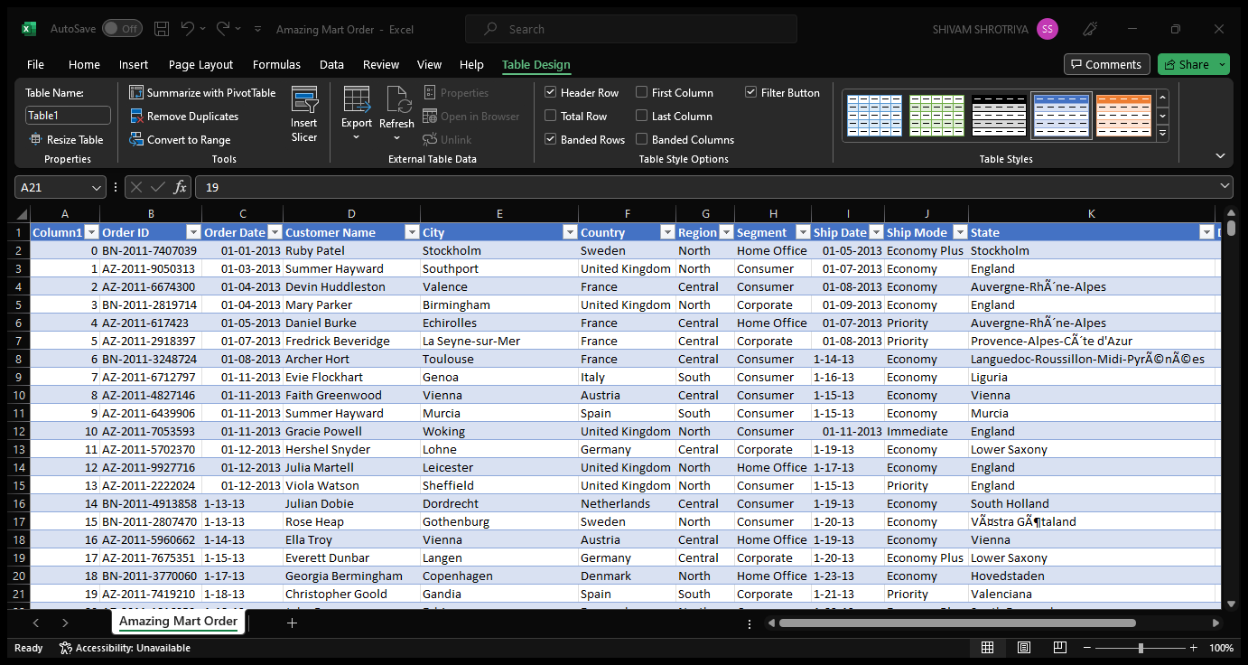
Dataset Snapshot:-
Amazing Mart Order Dataset:-

Slide 8
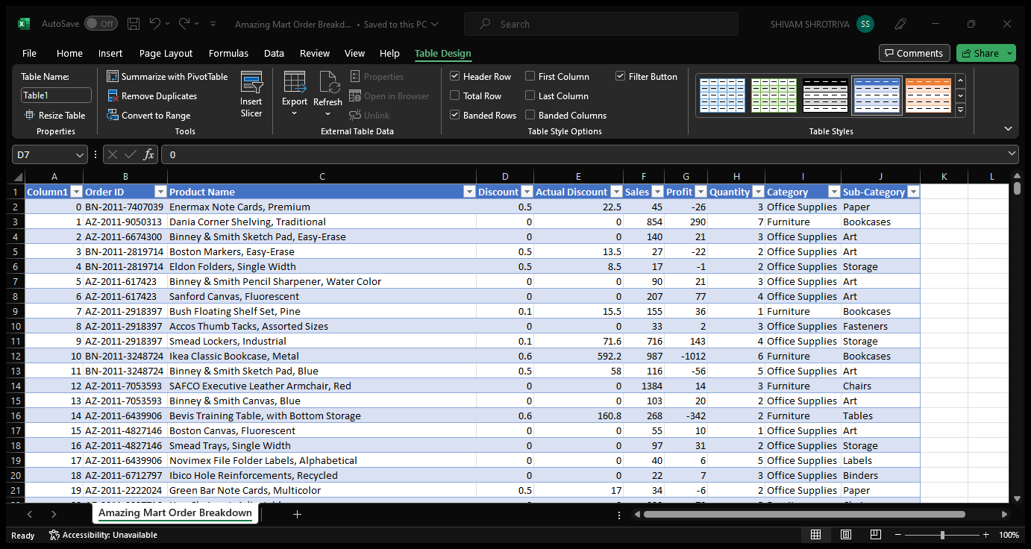
Amazing Mart Order Breakdown Dataset:-

Slide 9
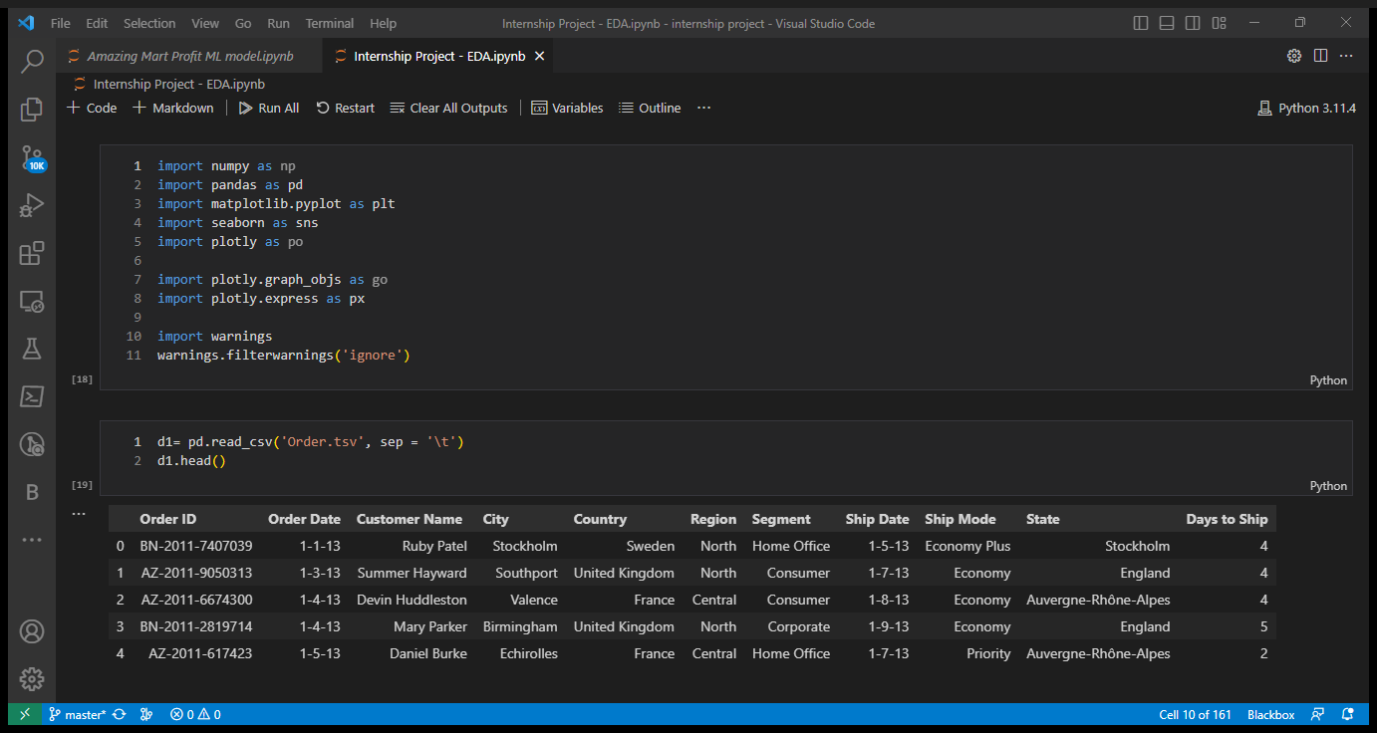
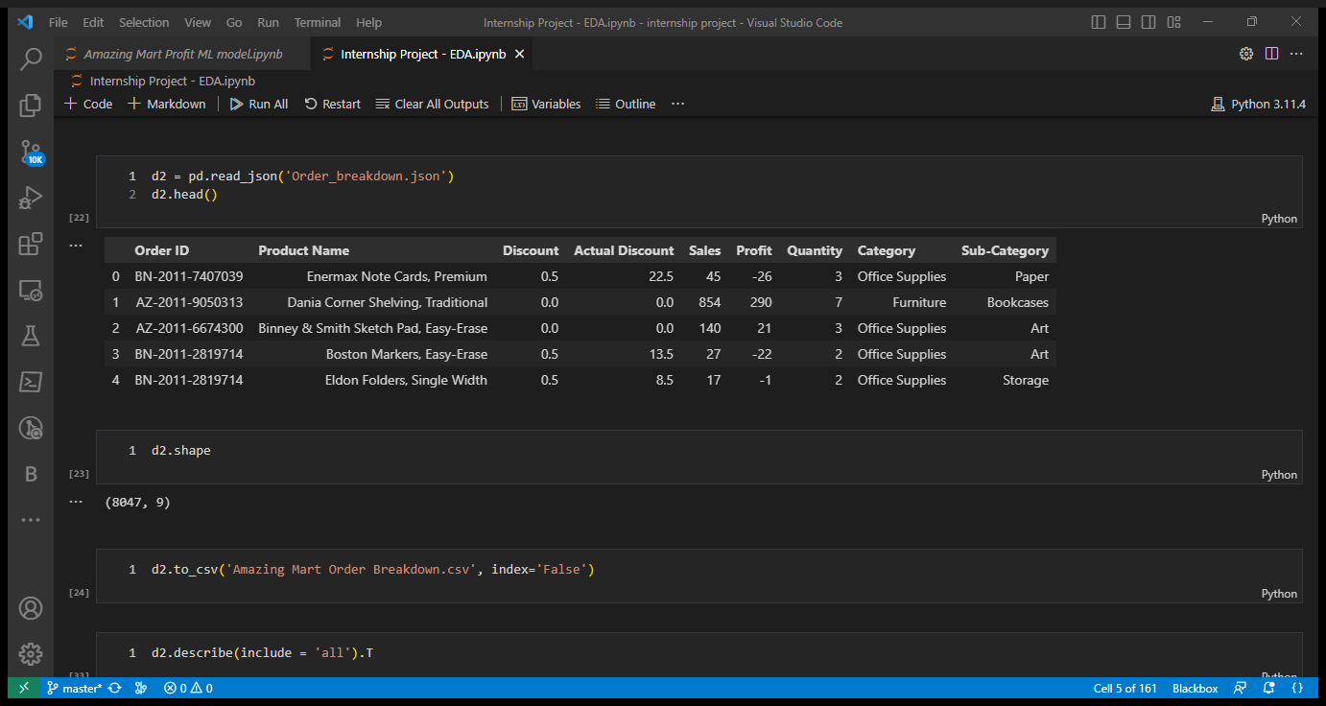
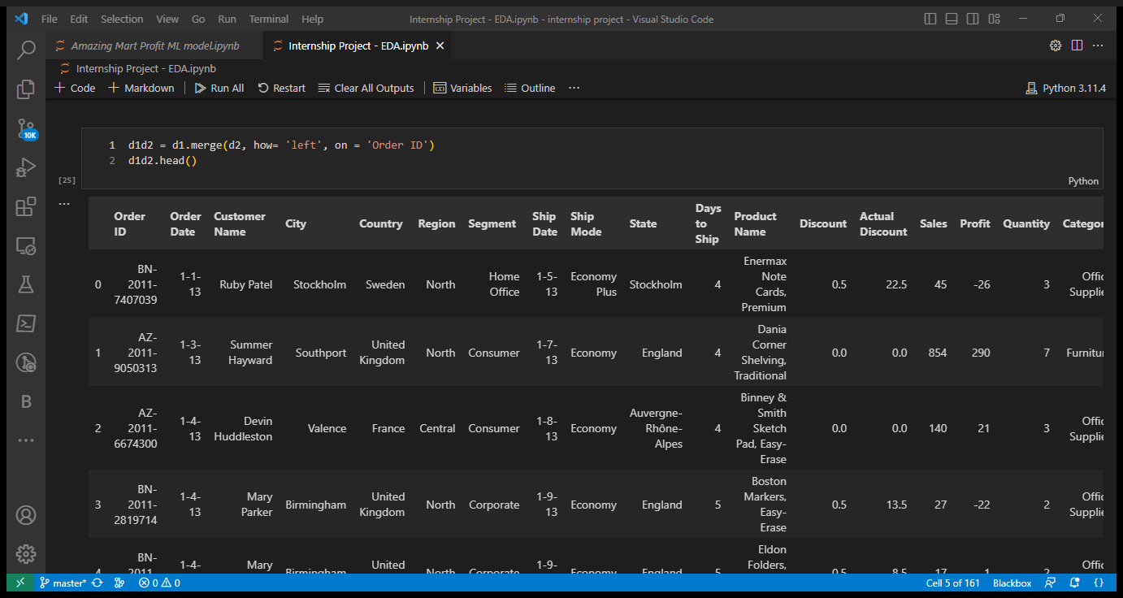
2. EDA and Graphical analysis
Exploratory Data Analysis :-
Loading DataFrames:-
Merging both data frames on Order Id:-

Slide 10
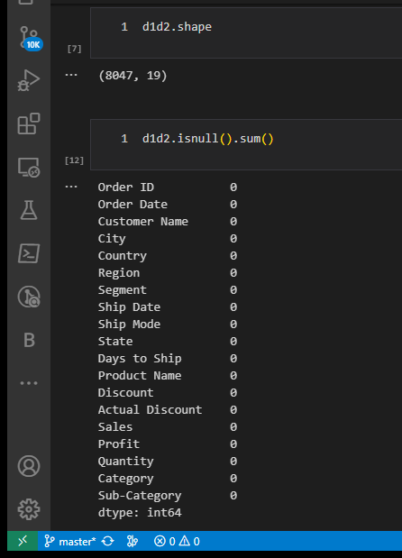
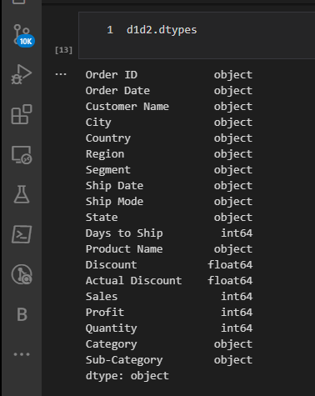
Checking Shape, null values and datatypes of columns in Data Frame:-

Slide 11
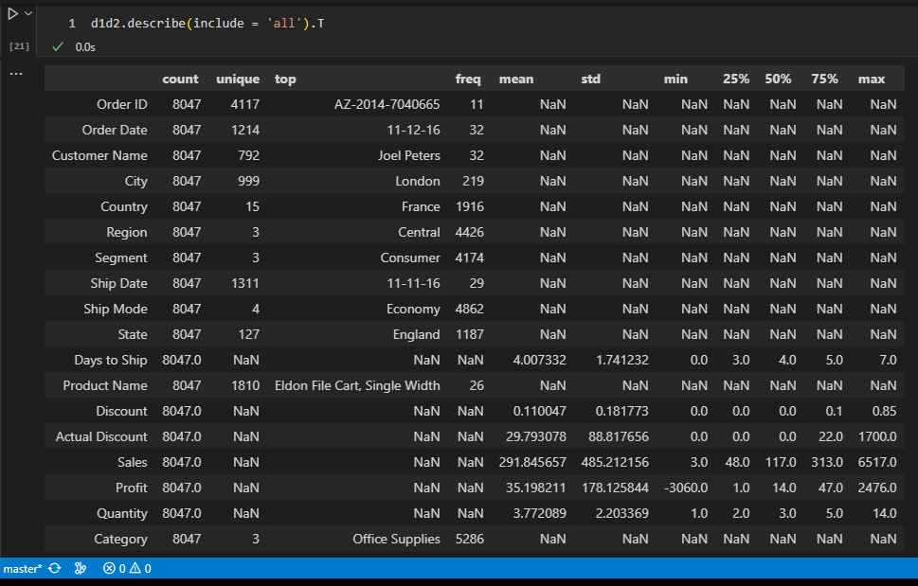
Checking Descriptive Details of Dataset:-

Slide 12
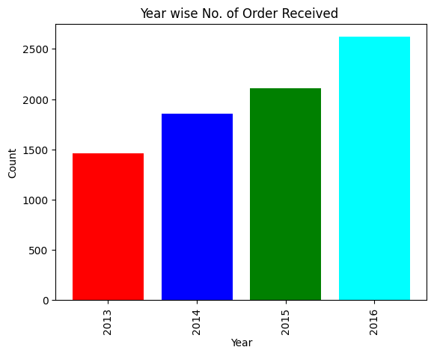
Graphical Analysis:-
Order Received Per Year:-
Insight:-
Most of the order are placed in 2016 and the graph shows gradually increase in order placing from year 2013 to 2016 in the Mart.

Slide 13
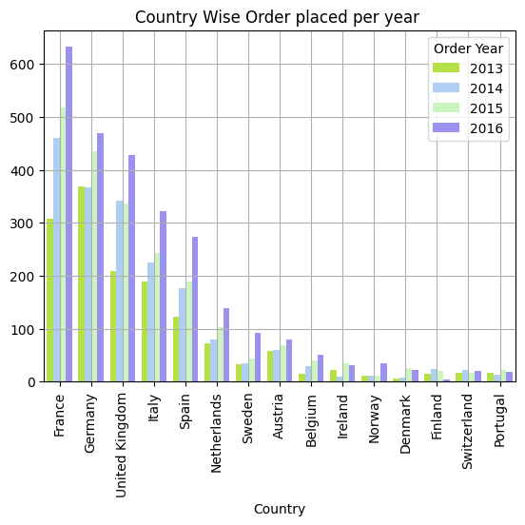
Country Wise Count of Order Received per Year:-
Insights:-
As per graph we can say that Most of the Orders are placed from France followed by Germany, United Kingdom, Italy and Spain Customers in year 2013,2014,2015, and 2016.
In 2016 highest order are placed from this country Customers.

Slide 14
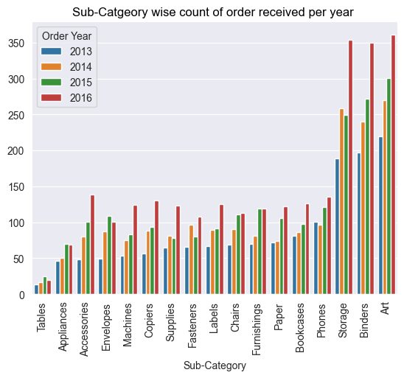
Sub-Category wise Order placing counts per year:-
Insights:-
So, it is clearly seen from the graph that year wise Art, Binders, and Storage are the most ordered sub-categories.

Slide 15
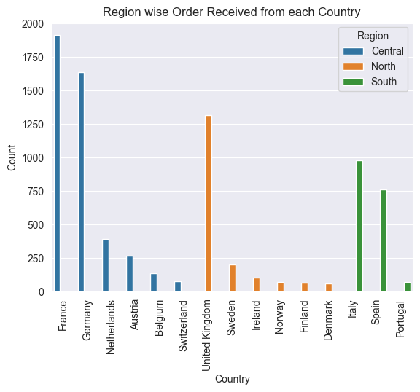
Region wise Order Received from each country:-
Insights:-
As per the graph we can say that Most of the Orders are placed Region wise France and Germany are countries of the Central Region from where the highest orders are placed, while the United Kingdom has the highest number of orders placed which comes under the North Region, and last Italy and Spain which belongs to South region has the highest orders are placed.

Slide 16
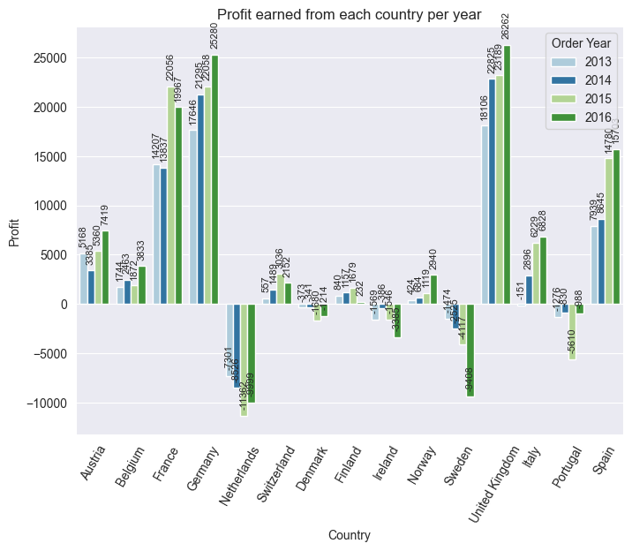
Profit Earned from each country per year:-
Insights:-
Graph shows that top 5 countries where Mart has earned most profit are as follows:
United Kingdom - North Region
Germany - Central Region
France - Central Region
Spain - South Region
Austria - Central Region
Few countries where we Amazing Mart facing losses in selling product there name are:
Netherlands - Central Region
Sweden - North Region
Portugal - South Region
Ireland - North Region
Denmark - North Region

Slide 17
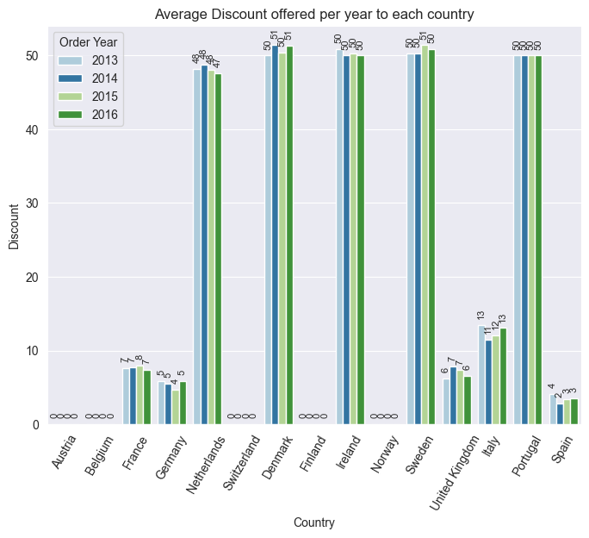
Average Discount Offered per year to each country:-
Insights:-
Countries where Amazing Mart offer the highest discount in selling product are:-
1. Denmark - North Region
2. Sweden - North Region
3. Ireland - North Region
4. Portugal - South Region
5. Netherlands - Central Region

Slide 18
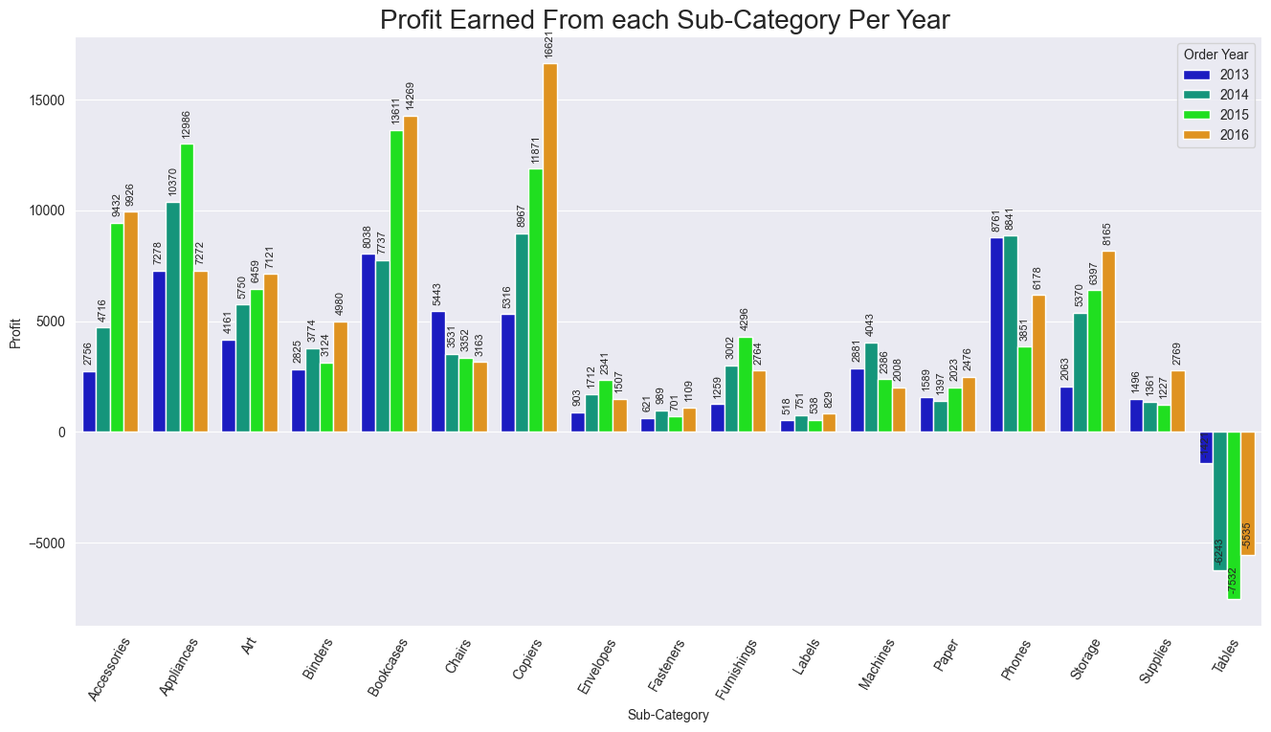
Profit Earned from each Sub-Category Per Year:-

Slide 19
Insights:-
From graph we can say that most profit earning sub-categories are:-
Copiers.
Bookcases.
Accessories.
Storage.
Art
There is sudden fall in profit can be seen in Appliances sub-category, while Tables sub-category is only facing losses in sales from year 2013 to 2016.

Slide 20
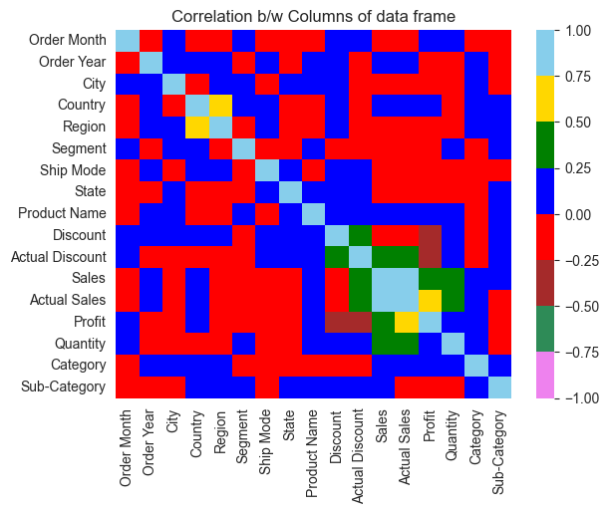
Correlation between Kilometre Driven vs Selling Price vs Year launched of Car Brands :-
Insights:-
There is a very less positive correlation between columns, most of the columns having a 0.25 correlation between each other, while most of the columns have a negative correlation of 0.25 between each other.

Slide 21
Conclusion:-
Order Trends and Peaks:
The order volume at Amazing Mart has shown a steady increase over time. Notably, the peak year for orders was 2016, indicating positive growth.
Monthly Order Patterns:
Monthly trends reveal that August consistently sees the highest order influx, followed by November, December, and June. However, July and October experienced significant drops in orders.
Regional and Customer Insights:
France and Germany are consistently the top order-placing countries, primarily from the Central Region. Meanwhile, the United Kingdom leads in the North Region, while Italy and Spain stand out in the South Region.
Sales and Profitability:
Central Region consistently achieves the highest sales and profits, with Technology being the leading revenue-generating category. Notably, Copiers, Bookcases, and Storage show upward sales trends, while Appliances and Tables face challenges.
Profit and Discount Trends:
The highest profits are derived from the Copiers, Bookcases, and Accessories sub-categories. Conversely, Appliances experience a notable profit decline, while Tables encounter continuous losses. Sub-categories like Tables, Chairs, and Phones offer significant discounts.
Geographical Profit and Discount Patterns:
Remarkably, the United Kingdom, Germany, and France are key contributors to high profits, while the Netherlands, Sweden, and Portugal indicate losses. Denmark, Sweden, and Ireland lead in offering discounts, showcasing regional pricing strategies.
Profitable Sub-Categories and Discount Trends:
Further analysis of sub-categories reveals that Copiers, Bookcases, Accessories, and Storage are the most profitable, while Appliances and Tables present challenges. Tables, Chairs, and Phones stand out for offering significant discounts.
Profit and Loss by Country:
Notably, the United Kingdom, Germany, and France lead in profit generation, while the Netherlands, Sweden, and Portugal experience losses. Strategic discounting is observed in Denmark, Sweden, Ireland, and Portugal.
Reference Python notebook file of EDA:-
EDA file on Github
EDA file on Google Drive

Slide 22
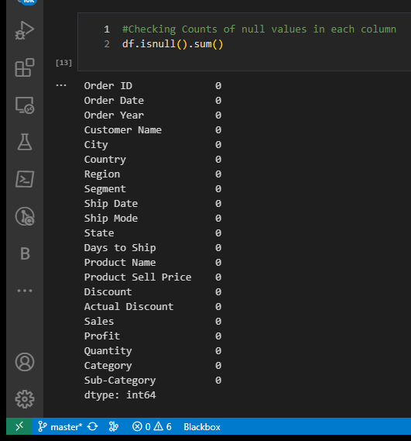
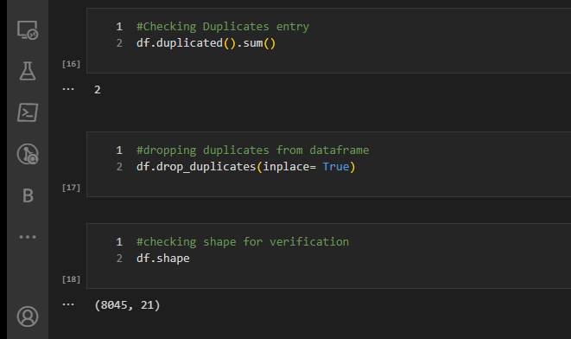
3. Data Cleaning and Data Preprocessing
Data Cleaning :-
Steps involve in data cleaning are:-
Checking Null Values and duplicates in dataframe, if present then replace null values with mean or median for numerical data types columns and with mode or some other separate representative value for categorical datatypes column, but in our dataset there is no null value has been present. If duplicates present then that can produce redundancy due to which model prediction has been to biased or wrong.

Slide 23
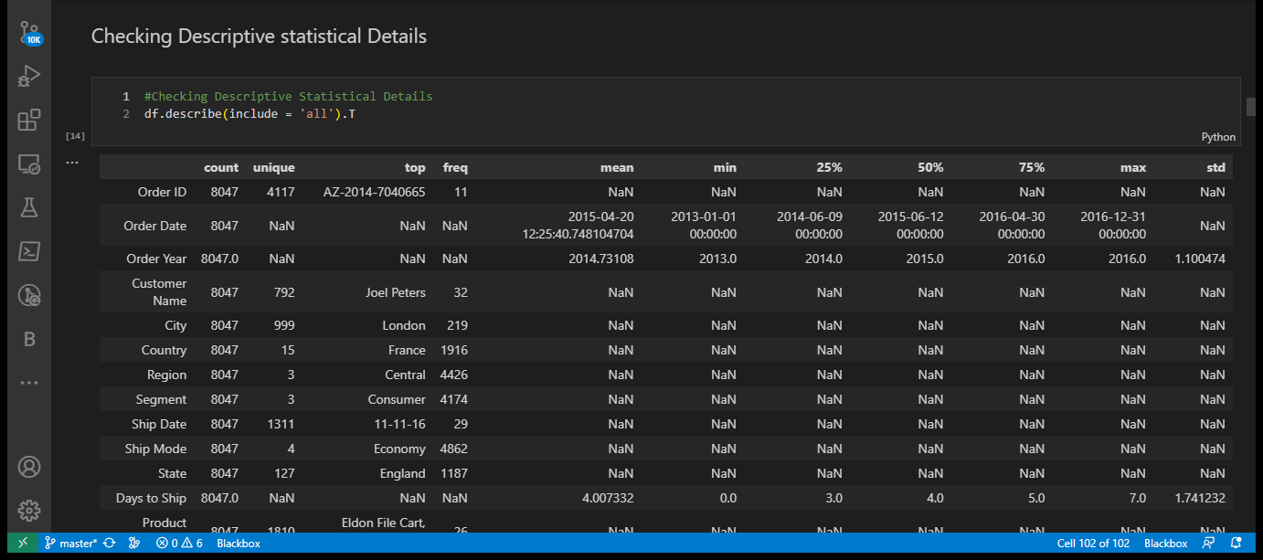
Checking Descriptive statistical details of dataset for checking 25%,50%,75% quantiles, max and min for numerical columns and frequency or mode of unique values present in categorical column.

Slide 24
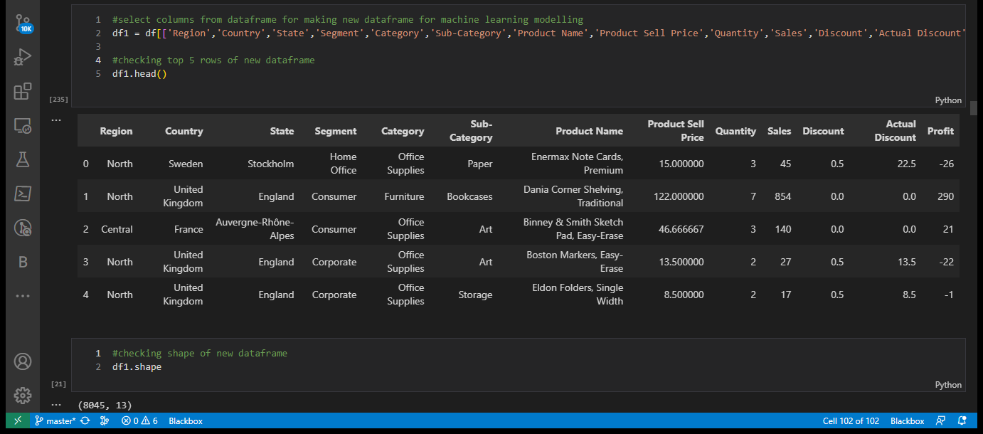
Selecting columns for making new dataframe for ML modelling.

Slide 25
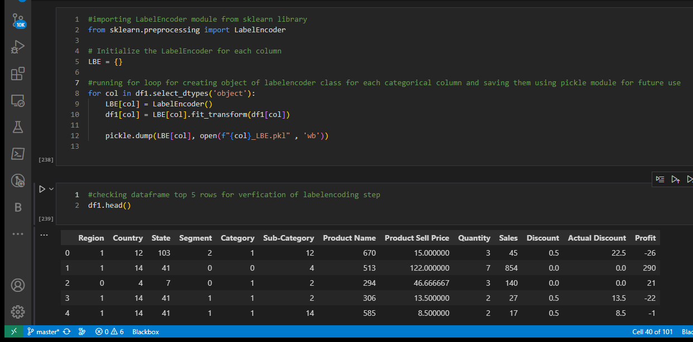
Data Preprocessing:-
Steps involve in data preprocessing are:-
Converting categorical Columns into integer data types for machine learning modelling because it only work on numerical data not on categorical data, we use LabelEncoder module of Scikit-learn library for converting categorical values to numerical values present in categorical columns.

Slide 26
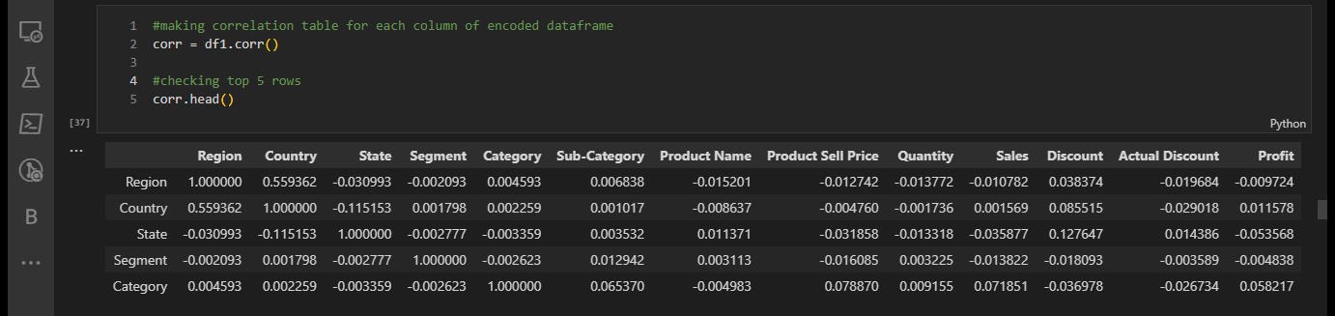
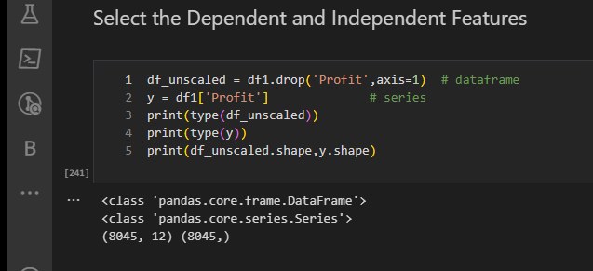
Checking Correlation between columns of dataframe:-
Separating Independent and Dependent variables for feeding in Machine Learning Model so that they can make prediction on dependent variable after training on independent variable.

Slide 27
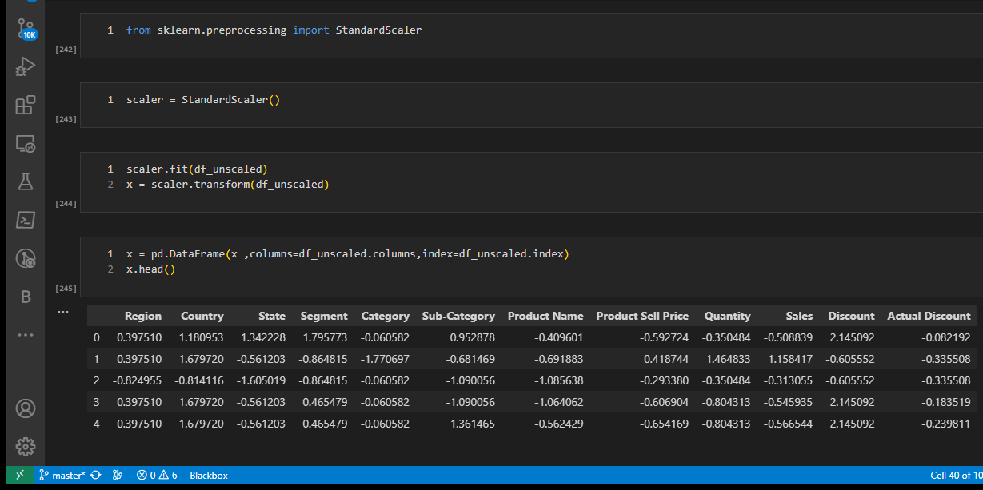
Scaling the dataset:-

Slide 28
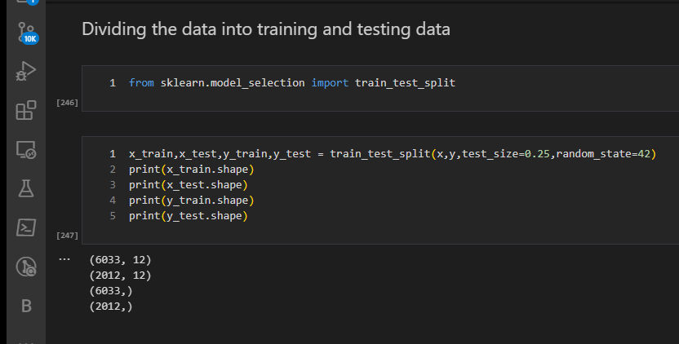
Splitting the data in to train and test data:-

Slide 29
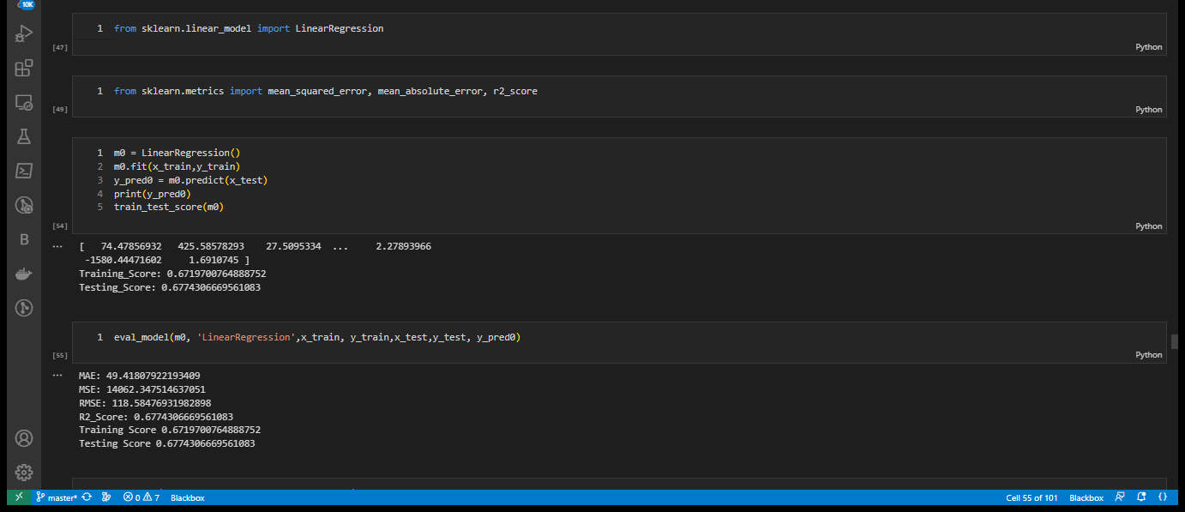
4. Machine Learning Modelling & Model Selection
Feeding Data:-
Feeding Training data and testing data to Machine Learning Model.
Model Training and Prediction:-
Training Linear Regression Model, K-Neighbors Regression Model, Ridge Model, Lasso Model, Decision Tree Regressor Model, Random Forest Regressor Model, Bagging Regressor Model, Ensemble using AdaBoost Regressor Model and Gradient Regressor Models on after training we test the model using testing data and checking Training Score, Testing Score or R2-Score, Mean absolute Error, Mean Squared Error and Root Mean Squared Error and selecting the model having high training and testing score and low Mean Squared Error, Mean Absolute Error and Root Mean Squared Error.
Linear Regression Modelling and Scores:-

Slide 30
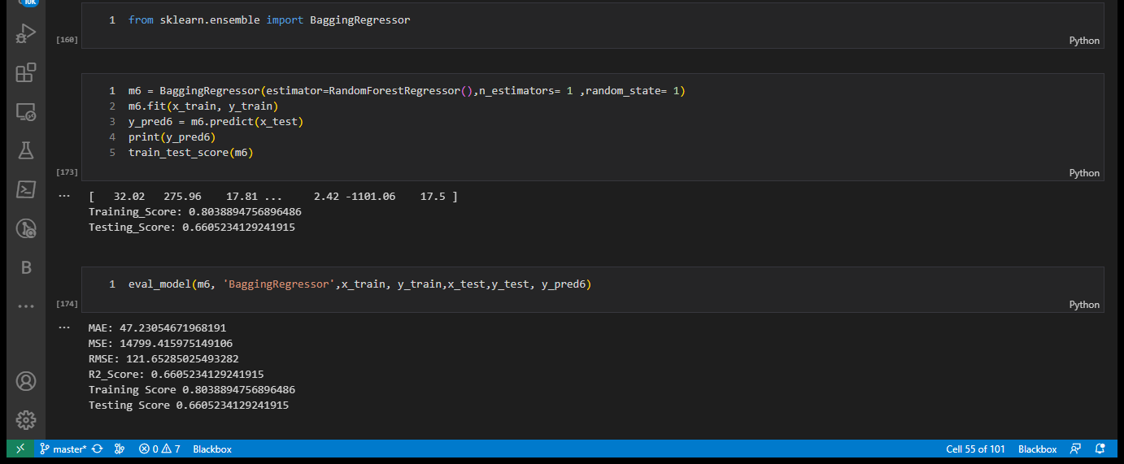
Ensemble (BaggingRegressor)Modelling and Score:-

Slide 31
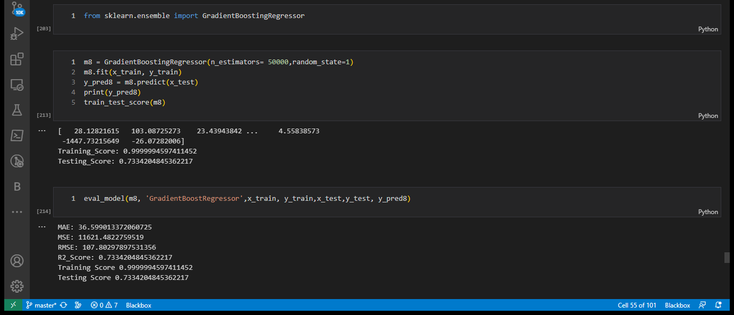
Gradient Boosting Regressor Modelling and Score:-

Slide 32
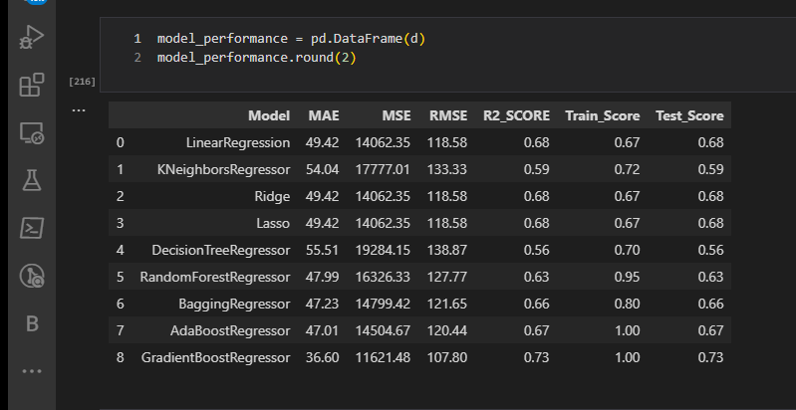
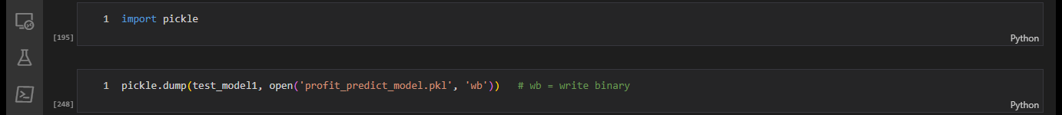
Model Evaluation and Model Selection:-
Creating Data Frame for Model Evaluation using Mean Squared Error, Mean Absolute Error, Root Mean Squared Error, R-2 Score (Testing Score) and Training Score.
Model Saving:-
So, as per the errors and Score mention above we choose Gradient Boosting Regressor Model for Profit Prediction Model using Pickle.
As per this data frame we choose Gradient Boosting Regressor as best model for Profit Prediction because it has Lowest MAE, MSE, RMSE and comparatively high R2-Score and Training Score.
MAE – 36.60
MSE - 11621.48
RMSE – 107.80
R2 – Score – 0.73
Training Score – 1.00

Slide 33
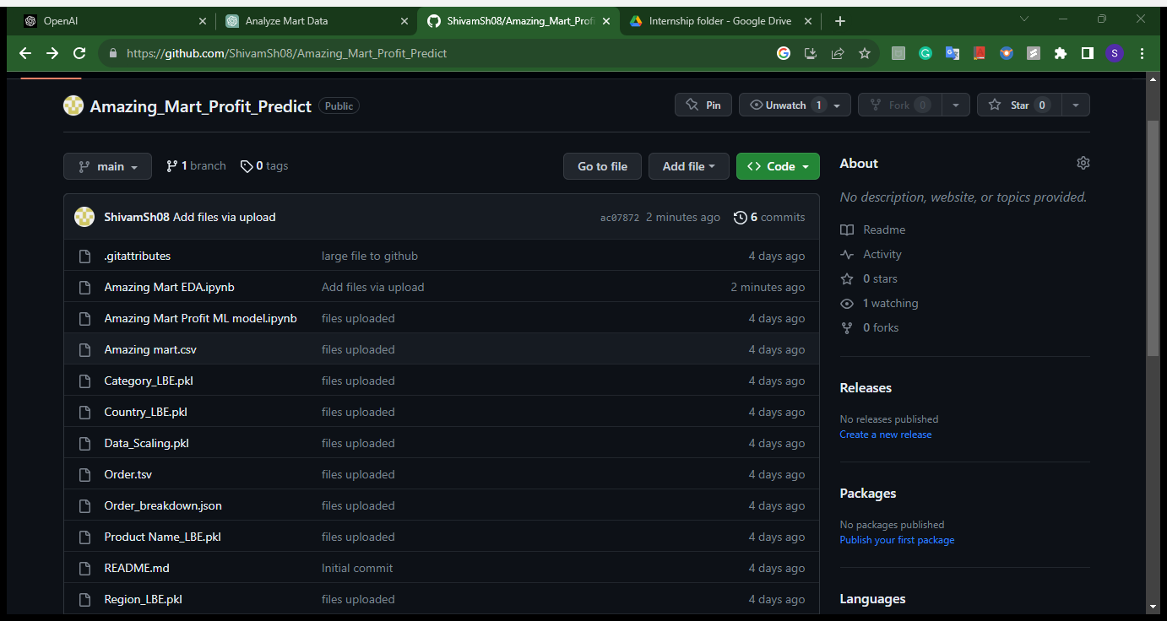
5. Github & Streamlit Website Screenshots and Links
Github Files Screenshot:-

Slide 34
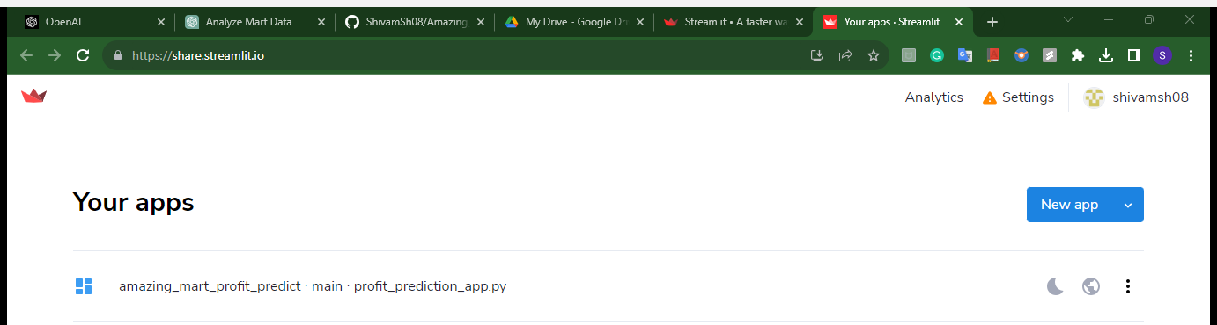
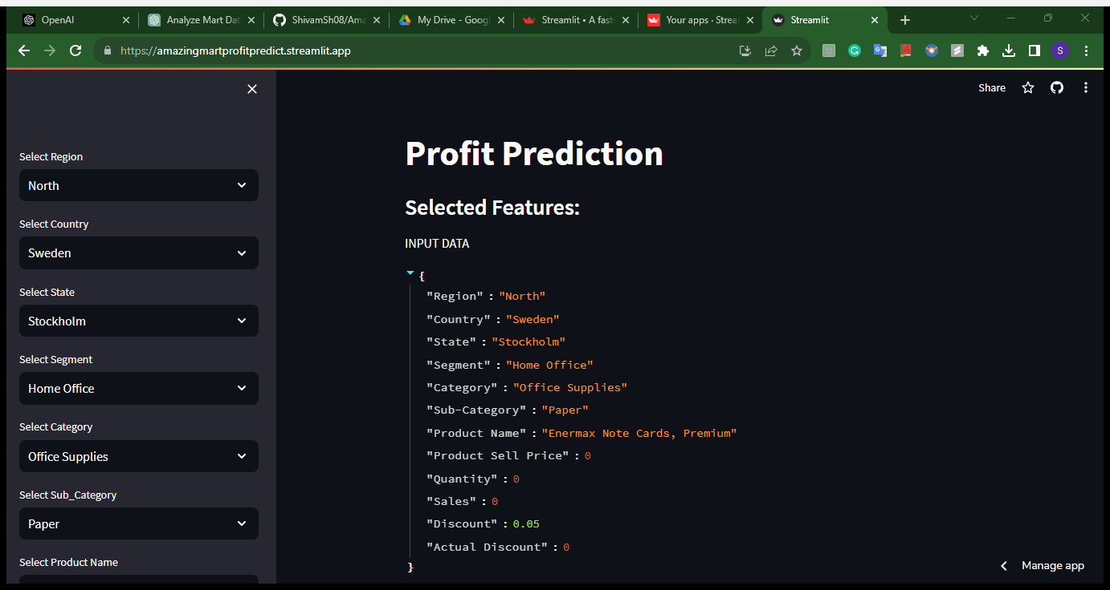
Streamlit Website Screenshot :-

Slide 35
Reference links:-
Reference links of EDA Python file, Price Prediction Modelling Python File, Github Account, and Streamlit App Website:-
EDA Python file:-
EDA file on Github
EDA file on Google Drive
Profit Prediction Modelling File :-
Model file on Github
Model file on Google Drive
Profit Prediction App File:-
App file on Github
App file on Google Drive
Git Hub Repo and Google Drive folder links of Amazing Mart Profit Prediction:-
Github Repo Link
Google Drive Folder link
Streamlit Website:-
Streamlit App Link
Thank you For Viewing.

